Slide 1
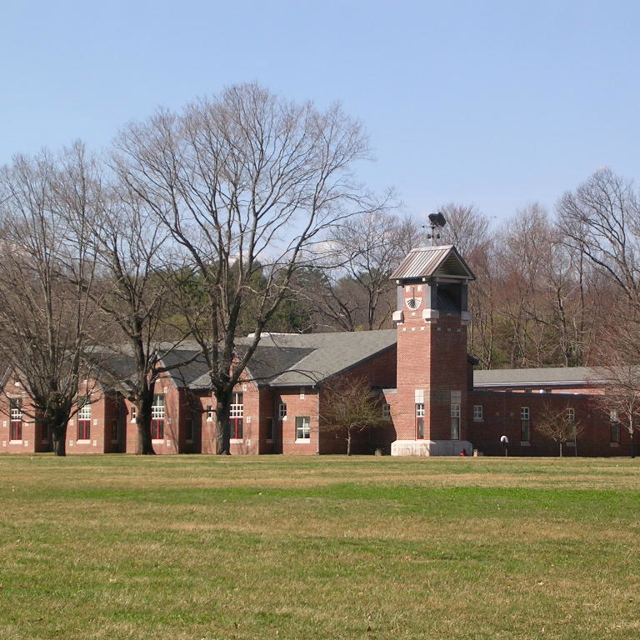
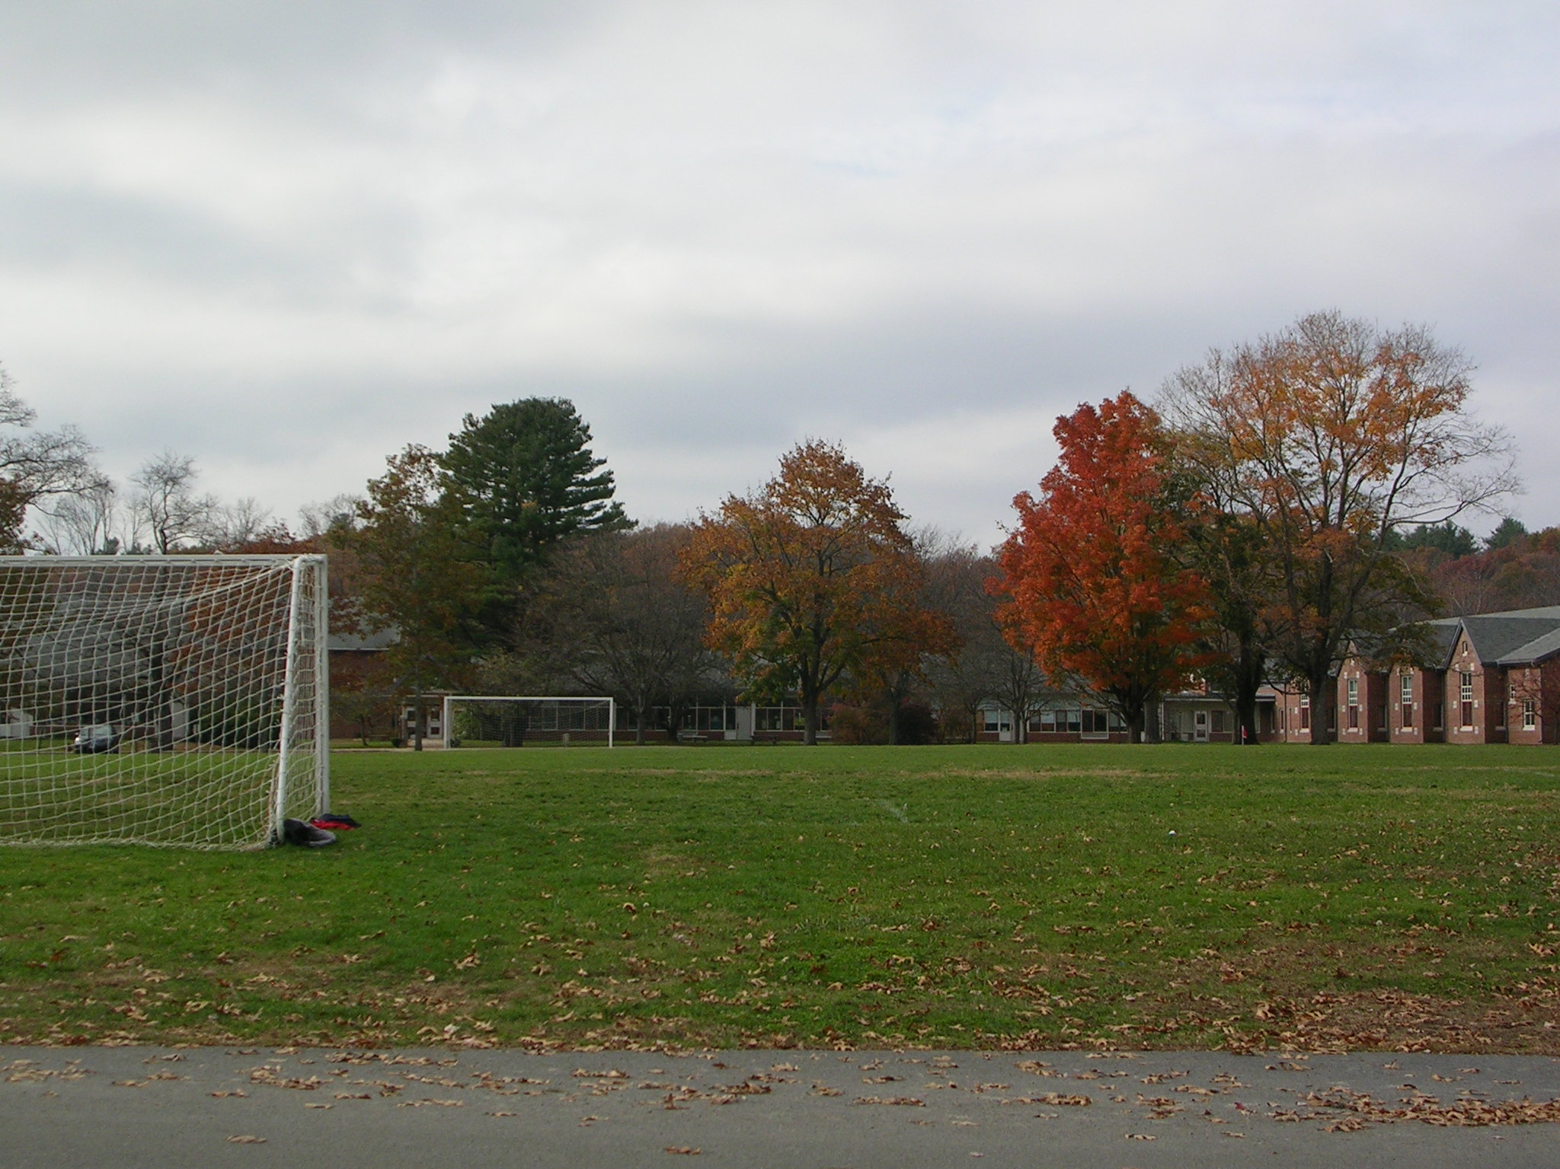
School Building Advisory Committee
June 27, 2013
School Design to Support Educational Vision
Notes:
Focus on vision for teaching and learning and our programmatic needs.
I am not focusing on the current deficits of the building with regard to basic needs such as temperature control although air quality these are big concerns - very high primary concerns.
As you begin this process, my hope is that you are thinking about the type of school this community will provide its children and how that school can support and enhance the teaching and learning that takes place inside.

Slide 2






21ST CENTURY SKILLS
Cultivating The Whole Child
  Academics
  Creativity
  Social/Civic
  Health/Play
  Emotional Well-being
Social/Civic
Creativity
Health/Play
Emotional Well-being
Academics

Slide 3
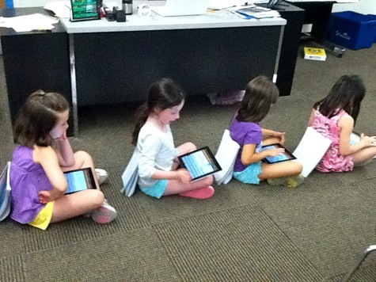
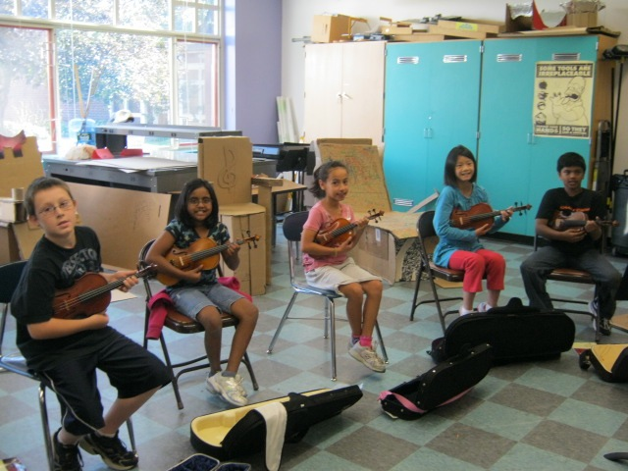
Educational Priorities
Programmatic flexibility: variety of spaces for small and large groups; spaces can be used for more than one purpose depending on educational needs
Accommodate fluctuations in enrollment
Enhance opportunities for student and staff collaboration
Improved educational environment (sound, light, air, temperature)
Technology infrastructure for current and future educational needs
Preserve on-campus agricultural and ecological education opportunities
Preserve on-campus athletic facilities

Slide 4
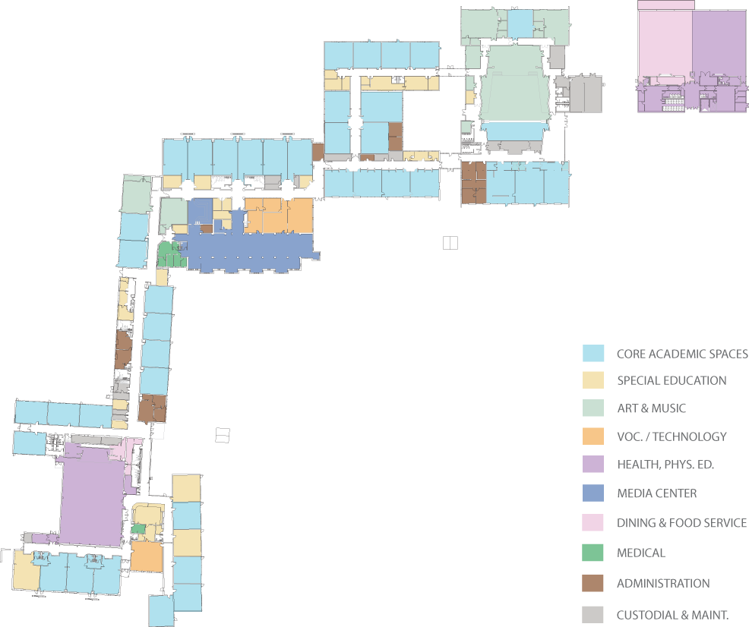
Existing Grade Layout
MUS
ART
GR 6
GR 4 & 5
GR 7 & 8
SC
GR 3
1948
1953
1955
1963
1970
1994
GR 2
GR 1
N
K
Notes:
This is our current Lincoln School layout. I thought it would be helpful to have this as a reference as I talk about the vision for education today and into the future to ask the question of whether this layout helps us to meet that vision.

Slide 5
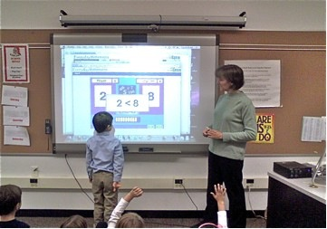
Core Expectations for Teaching and Learning
Collaboration
Differentiation – meeting the individual learning needs of each student
Integration of Technology
Purposeful, authentic learning experiences
Inclusion model of Special Education
Notes:
Teaching and learning have changed a great deal since any of us were in elementary or middle school. There is now a set of core expectations, none of which were in place when we were students.
Core Expectations of Teaching and Learning
Collaboration
Differentiation – meeting the individual learning needs of each student
Integration of Technology
Purposeful, authentic learning experiences
Inclusion model of special education

Slide 6
Collaboration
What’s Needed?
A building that allows for greater formal and informal collaboration between teachers and students.
  Spaces designed for small groups
  Spaces for larger groups such as a grade level
  Group spaces easily accessible by multiple users
  Core facilities (e.g. cafeteria, gyms, library) easily accessible to all students
Why?
Collaboration develops problem-solving and communication skills. Creativity and innovation are fostered. Teachers share their expertise to benefit all students.
Notes:
No longer my classroom, my students Now it’s our classrooms and our students
High levels of collaboration between students and between faculty are an expectation. The new MA Teacher Evaluation system set as an expectation that teachers create team goals for student learning and work together to achieve these goals, this is because there is significant research that says that when teachers work together towards measurable goals for student achievement, teaching improves and thus learning increases. Teachers are expected to work together on curricular projects and assessment. It is no longer acceptable for teachers to work alone in their classrooms. We expect the same for students. Businesses report that the greatest skills we can develop in students are their problem-solving, communication, and collaboration skills. It is essential that we provide students with the learning experiences that will lead to these skills. Collaborative learning allows students the opportunity to be creative and innovative in the ways that they demonstrate understanding of concepts.
What’s needed?...

Slide 7
Differentiation
What’s Needed?
Small breakout rooms “within” but separate from classrooms
Why?
Independent small group work: supports projects & students ready for additional challenges
Small group work with a teacher: supports students at all levels
Students can be observed by the teacher and have access to classroom materials
Notes:
We expect teachers to adjust their instruction to meet the individual needs of the wide range of students in their classes. Teachers must truly know each student as a learner and make daily decisions about how to adjust the learning experiences for each student. Currently teachers accomplish this by having students work in various areas of the classroom or they go out into the hallway to work with little supervision.
What’s needed?...

Slide 8
Integration of Technology
What’s Needed?
New wireless infrastructure
Increased bandwidth
Why? Teachers require consistency of connectivity in order to invest time and effort into developing integrated instruction.
Provide adequate access to technology hardware:
  Projection systems
  Interactive white boards
  Document cameras
  Computers
  Individual devices such as iPads or Chrome Books
Plan so that upgrades can be more easily performed in the future
Notes:
We expect teachers to integrate the use of technology into instruction and teach students to utilize technology in their learning. Currently, our wireless infrastructure does not provide consistent access and our bandwidth is insufficient for the work teachers are trying to do with students. The technology infrastructure is a limiting factor in setting expectations for how teachers and students use technology.
Why?...

Slide 9
Purposeful, Authentic Learning Experiences
What’s Needed?
Learning spaces that are alternatives to classrooms
Range of group sizes (e.g. a few students or a whole grade)
Flexible: not as specialized as an auditorium, library, or gym.
Why? Authentic learning can take many forms such as an exhibition of work, a poetry slam, a presentation to the conservation commission.
Notes:
When students are engaged in their learning they achieve at higher levels. Teachers are expected to design learning experiences that; engage students in high level critical thinking, are authentic and meaningful such as project based learning. For example, we are embarking on a project to redesign the boardwalk going through the wetlands behind Smith. Wouldn’t it be great if students designed that boardwalk, developed presentations that they actually gave to the conservation commission, regularly monitored the water quality and provided longitudinal data to the Town. This type of work cannot be carried out in classrooms and hallways. Alternative spaces that are flexible enough to be used with different sized groups and for various purposes are needed.

Slide 10
Students (PreK-8) in Special Education in the Lincoln Public Schools as of October 1st
Year | Lincoln | Hanscom | Total | District Percentage | State Percentage
2007 | 78 | 83 | 161 | 13.21 | 16.87
2008 | 78 | 78 | 156 | 13.85 | 17.12
2009 | 64 | 61 | 125 | 11.90 | 17.00
2010 | 66 | 71 | 137 | 12.72 | 17.00
2011 | 71 | 72 | 143 | 12.34 | 17.00
2012 | 86 | 93 | 179 | 14.20 | n/a
Students in Special Education
 | Oct. 1st 2011 | Oct. 1st 2012
Lincoln School K-4 | 32 | 35
Lincoln School 5-8 | 29 | 40

Slide 11
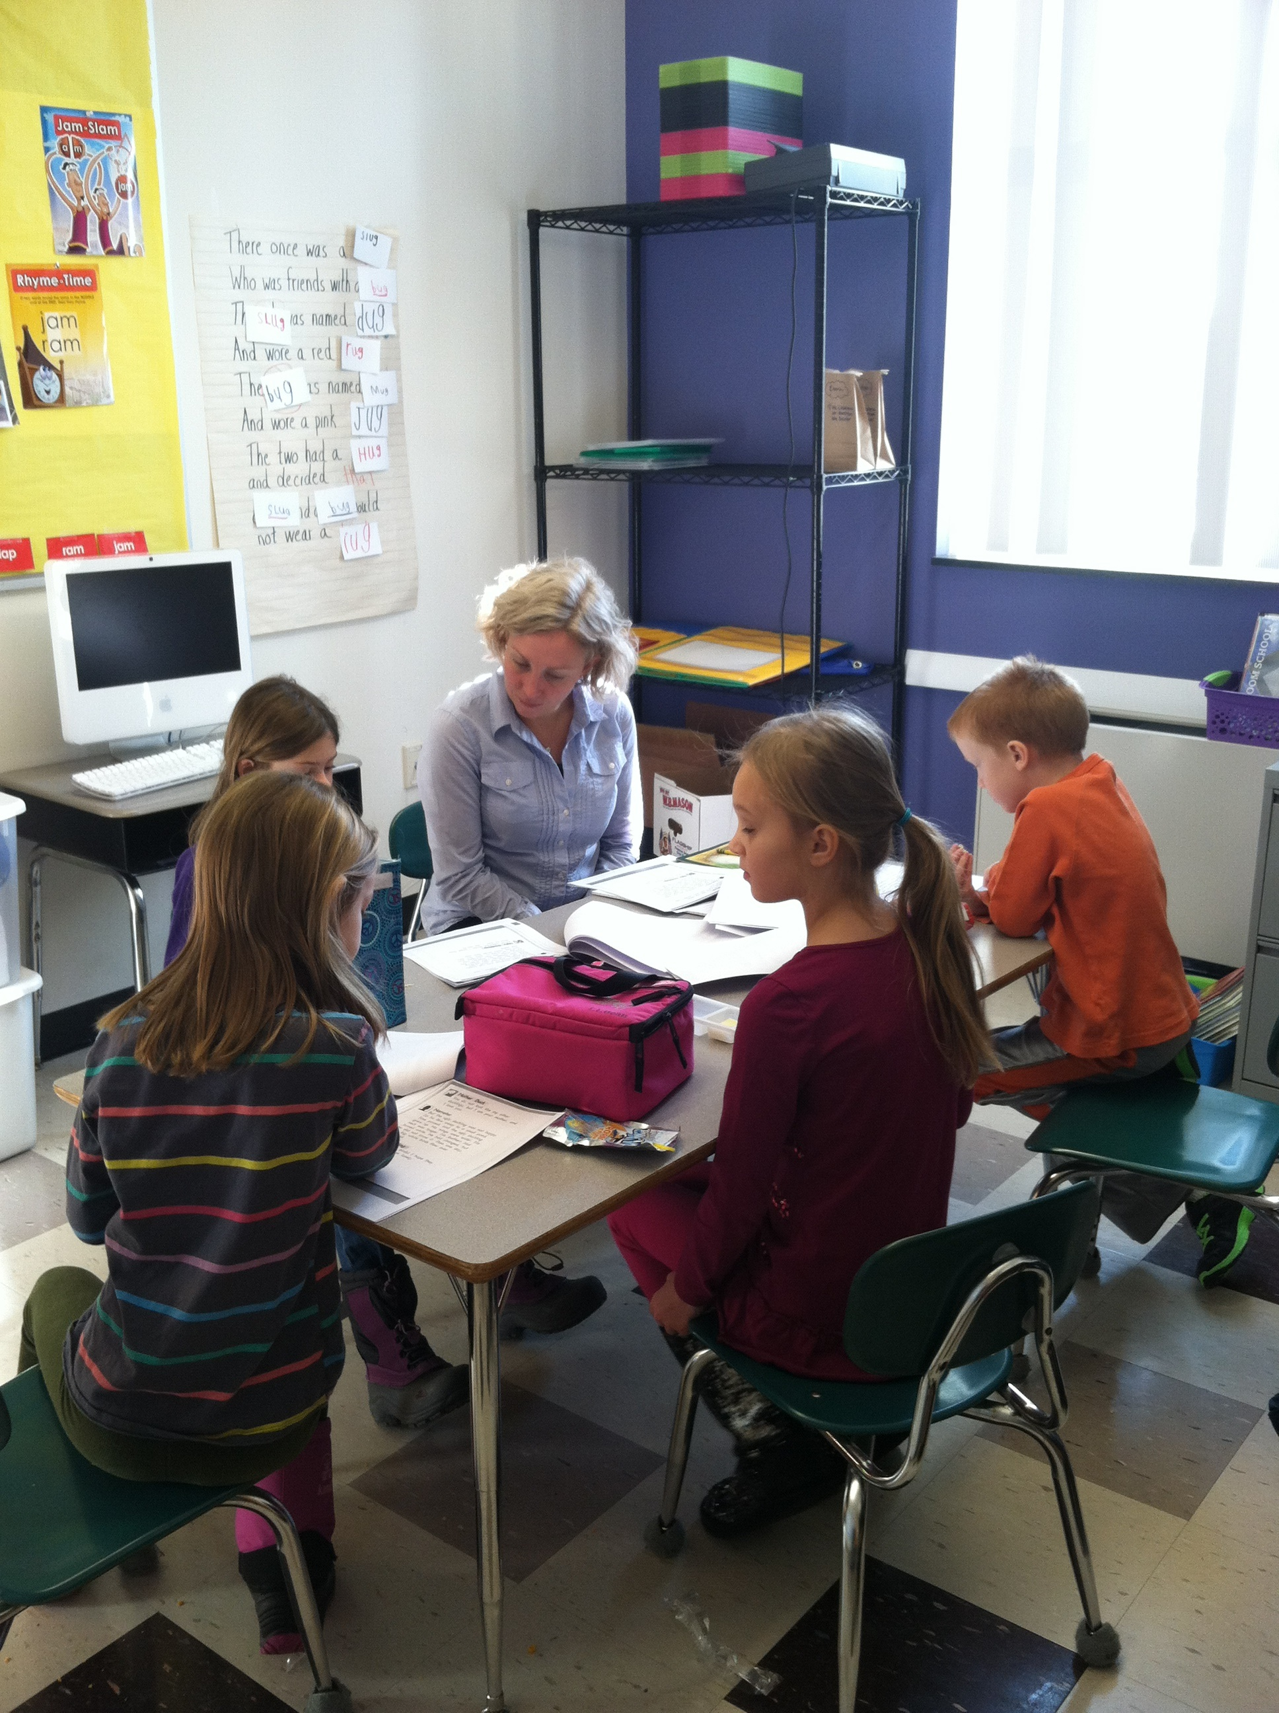
Inclusion Model of Special Education
What’s Needed?
Small break out rooms within classrooms
Why?
Provide services to an individual student or small group
Less disruption to the child and the class as a whole
Less travel time
Notes:
The Lincoln Public Schools are committed to a model of inclusion in special education. We are committed because we believe that in most cases, this is the best way to help individual students to be successful learners and well-rounded individuals. It builds a more diverse and tolerant community, and it also has a financial benefit to the district. But to do it well requires skilled teachers, and the appropriate spaces for supporting that teaching.
We want to keep students in their classrooms as much as possible, in the least restrictive environment rather than pulling them out for specialized instruction. This is more effective instructionally, is more efficient and has a variety of learning and social benefits for all students.
What’s needed?...

Slide 12
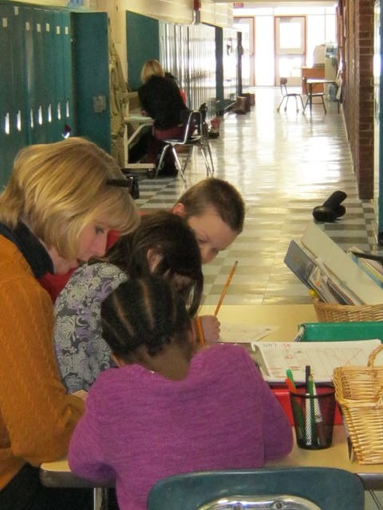
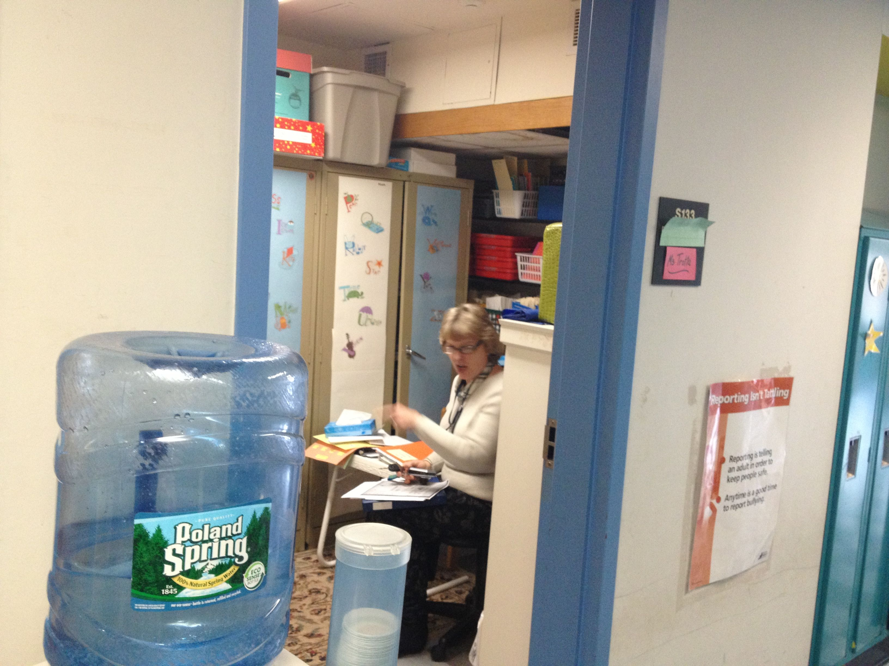
Current Working Spaces for Students and Faculty
This closet converted into a small learning space is used to service English Language Learners.
Small group instruction takes place in hallways.
Notes:
From an email message today from a literacy specialist to classroom teachers:
I need you to email times when we can NOT come and take students. It's preferential to not take kids during a snack or free time when other kids might be entering and exiting the classroom more frequently than normal, as this is really distracting for the child being assessed... and harder for the assessor to hear. We should have each child out of the room for only 4-5 minutes, so please be as flexible as you can in regards to timing.

Slide 13
Hanscom School Design

Slide 14
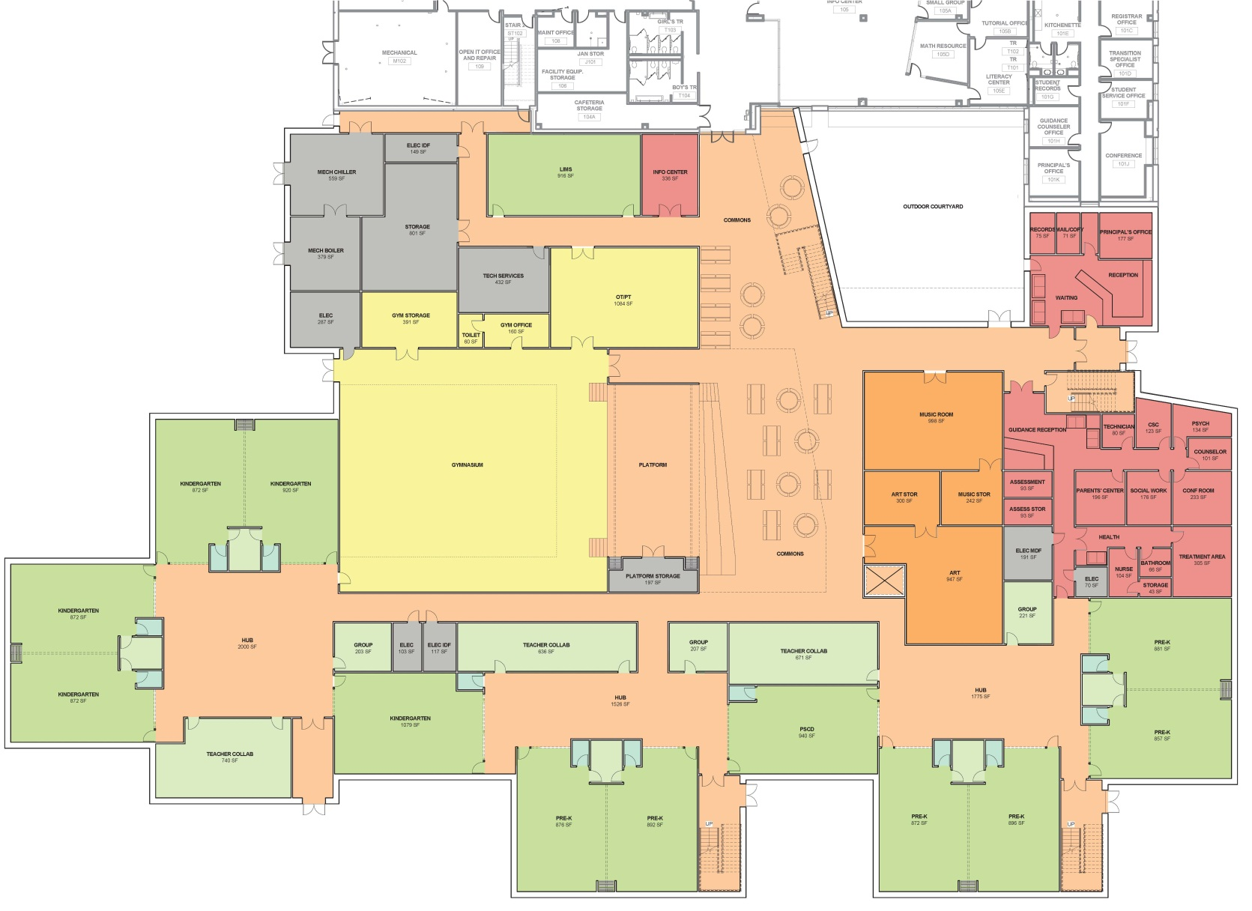
Scheme A – Distributed Neighborhoods with Flex Studios

Slide 15
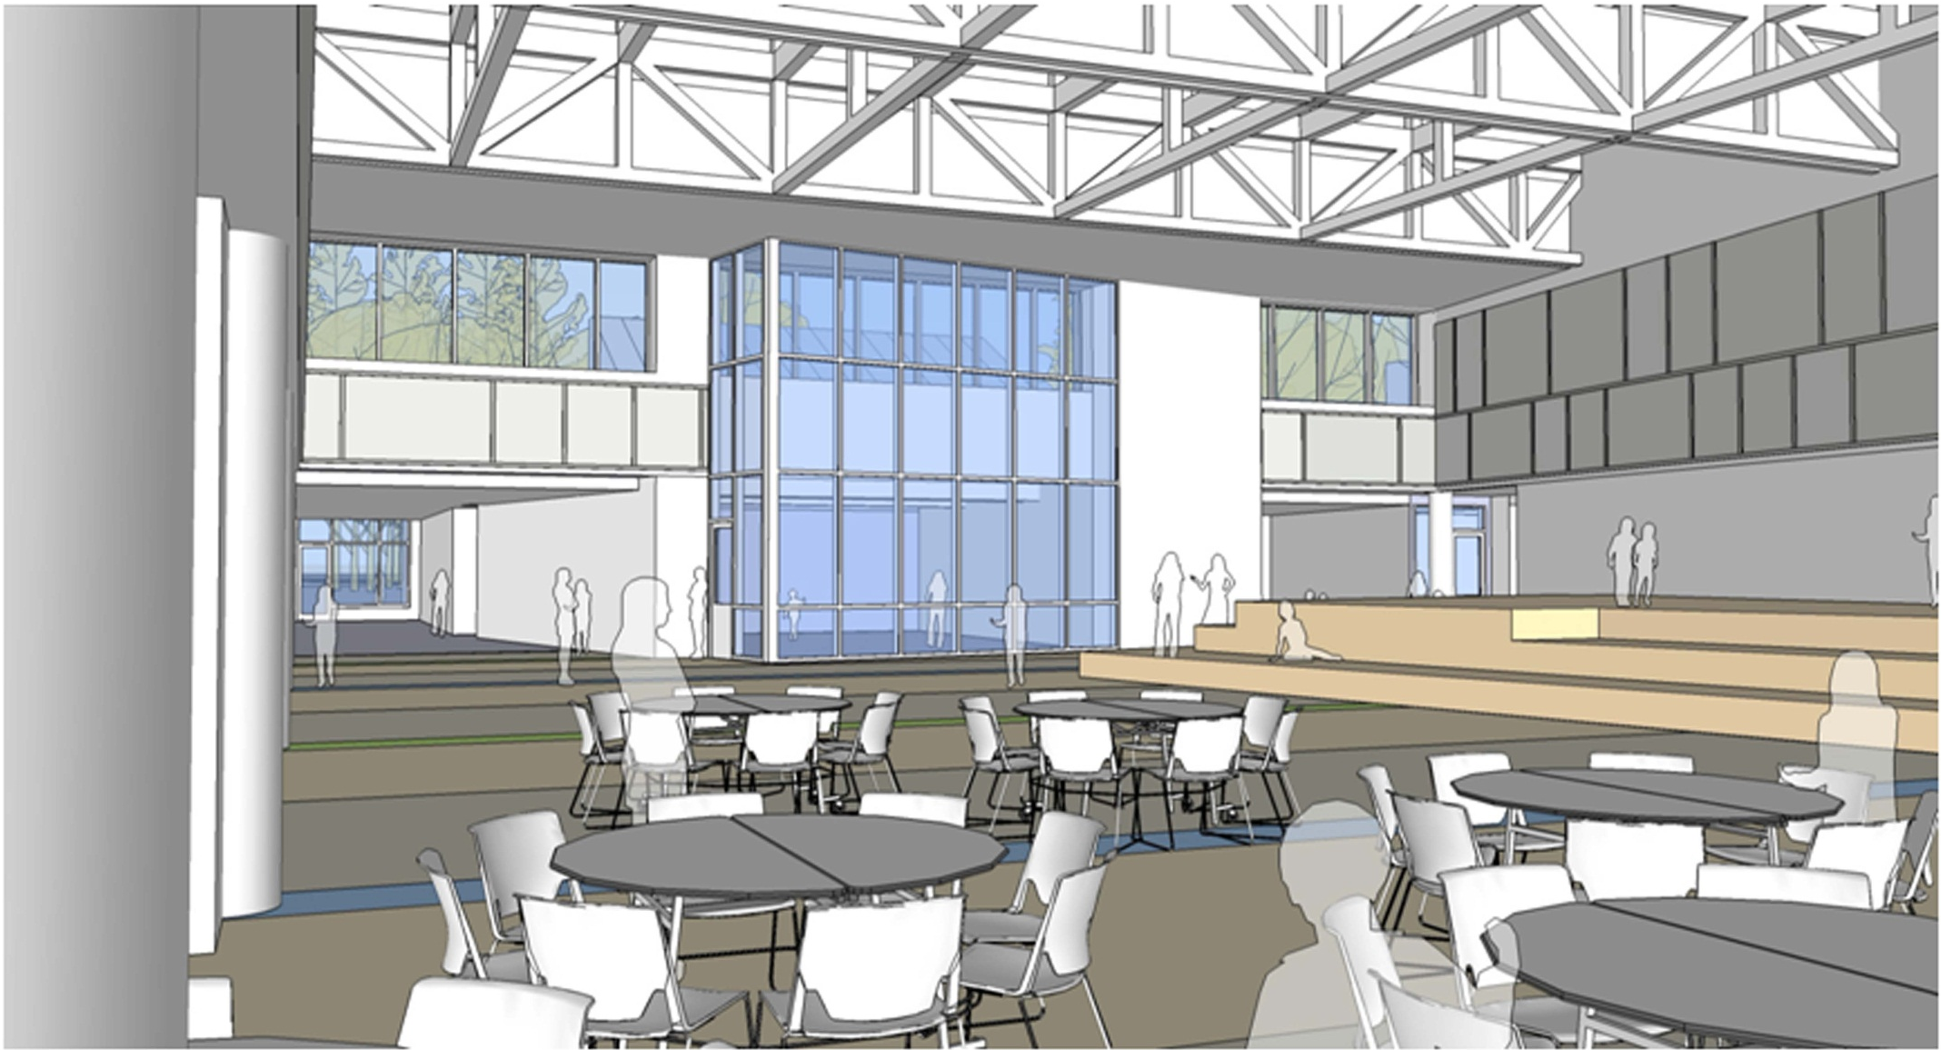
Flexible Spaces
HANSCOM MIDDLE SCHOOL FINAL DESIGN – COMMONS

Slide 16
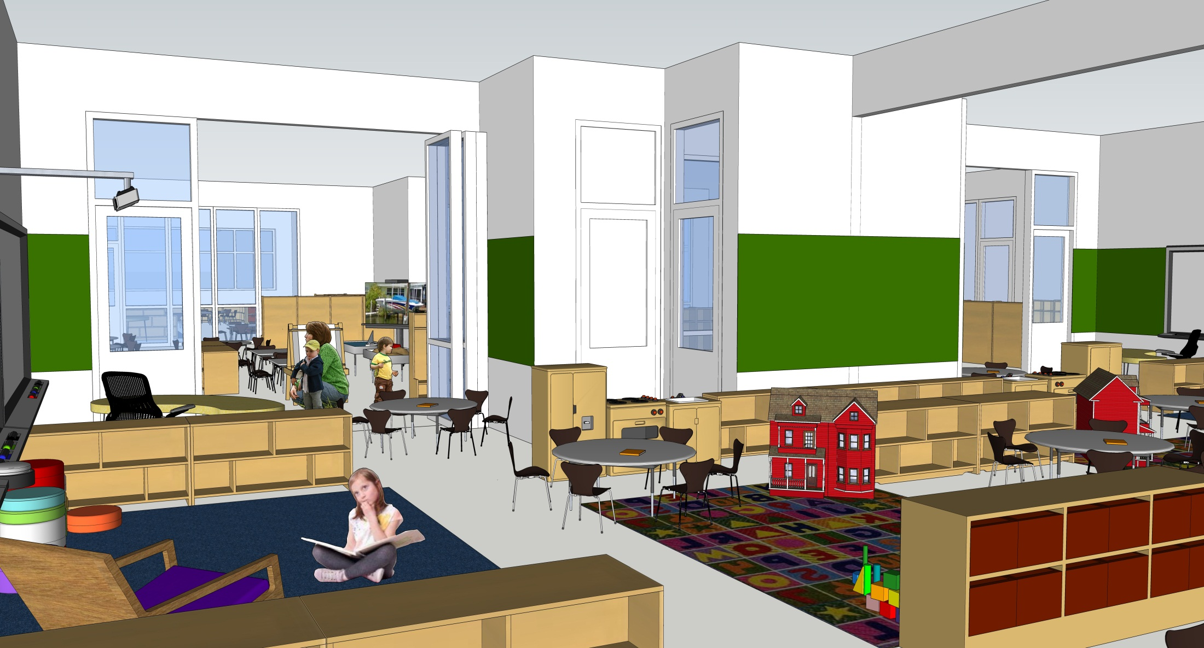
STUDENT WORK DISPLAY OPPORTUNITIES

Slide 17
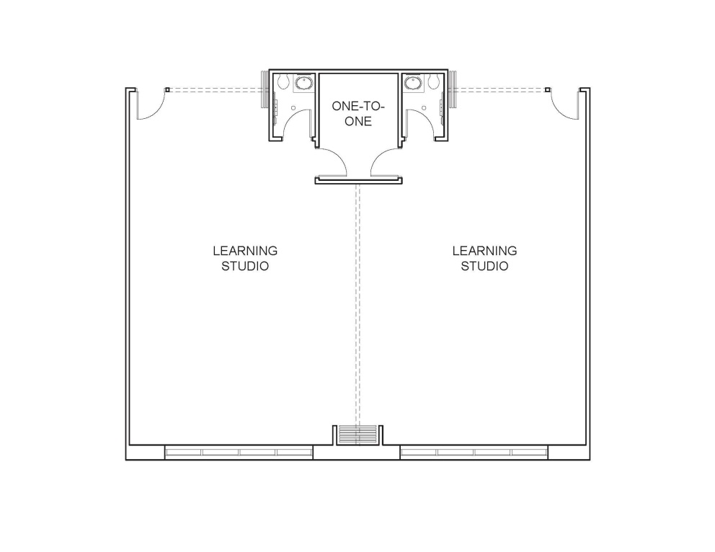
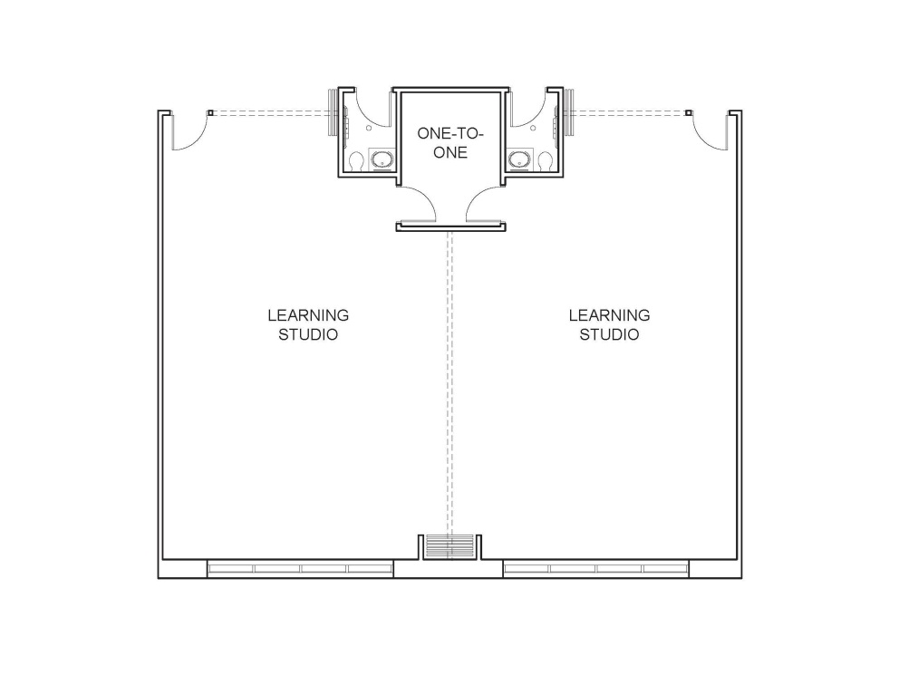
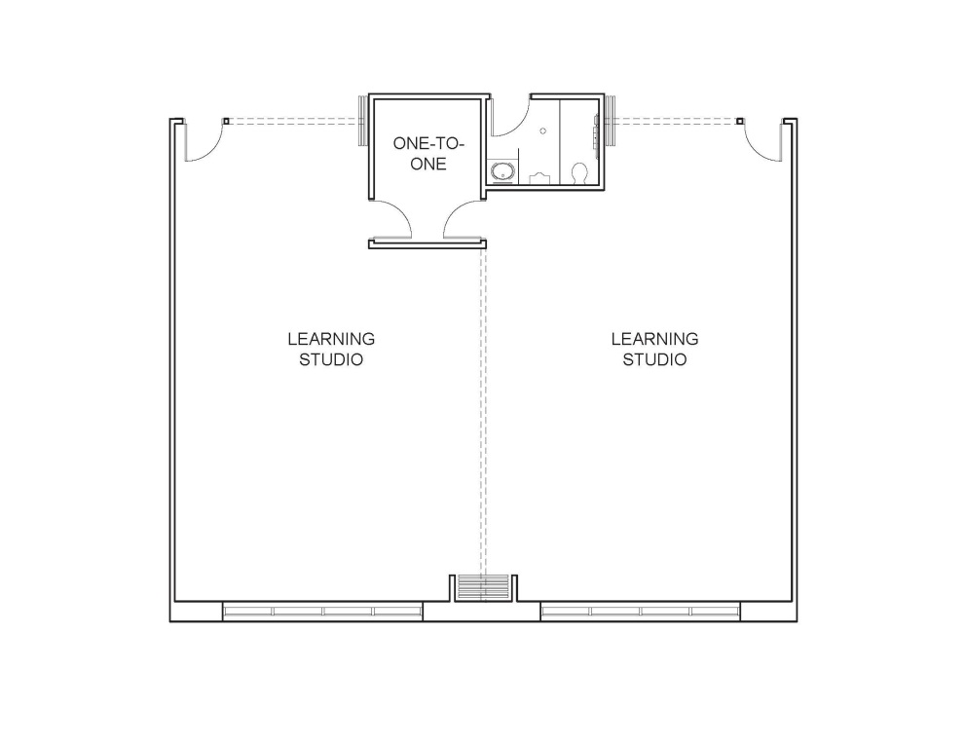
Hanscom PK/K Proposed
Hanscom Grades 1-3 Option
Hanscom Grades 1-3 Option
TYPICAL STUDIO OPTIONS

Slide 18
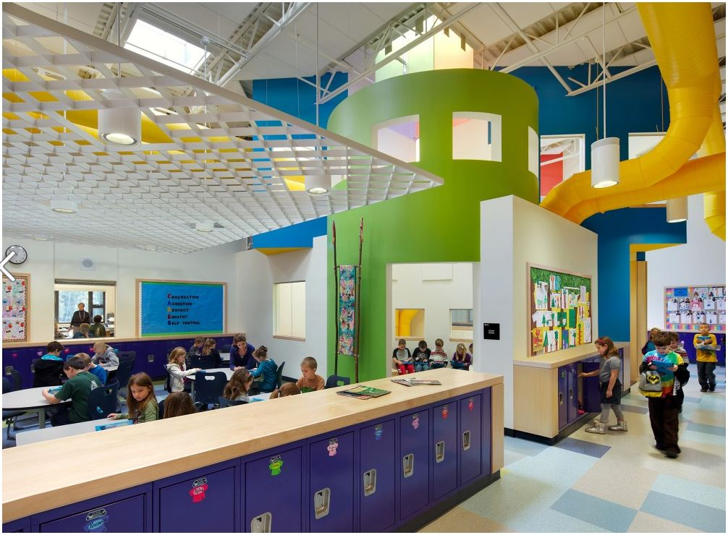
Concord Schools, New Hampshire– HMFH Architects

Slide 19
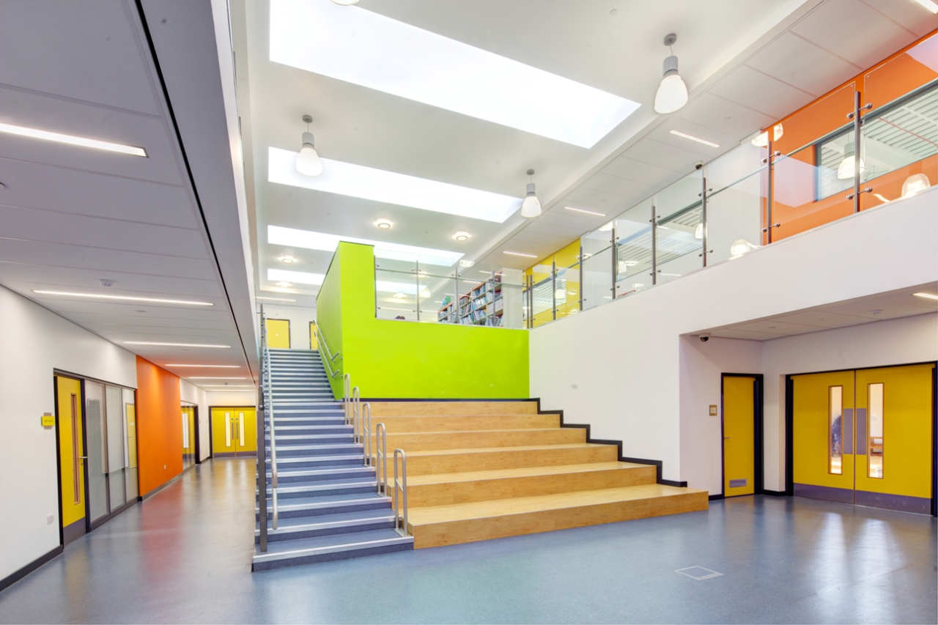
Park Brow School, Liverpool England – 2020 Liverpool

Slide 20
